Slide 1
Modeling Advection-Diffusion w/ Finite Difference Method
Ayden Wolgamott

Slide 2
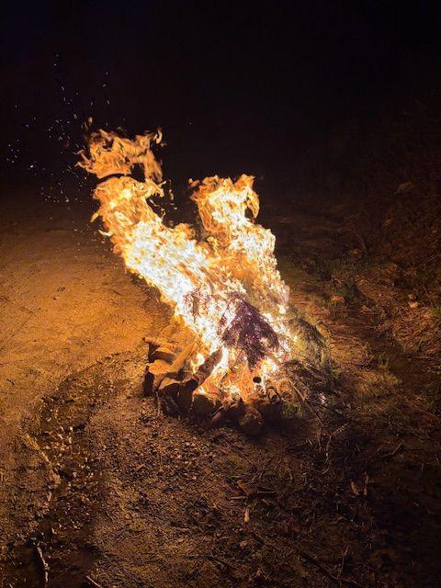
Why Advection-Diffusion?
Wanted to be able to model the movements of forest fire using PDEs
Proved to be way over my head
Led me to look into natural characteristics in fluid dynamics which are also crucial in how fire spreads
Brought me to advection and diffusion, proving to be great eq.’s for me to learn FDM using Maple!

Slide 3
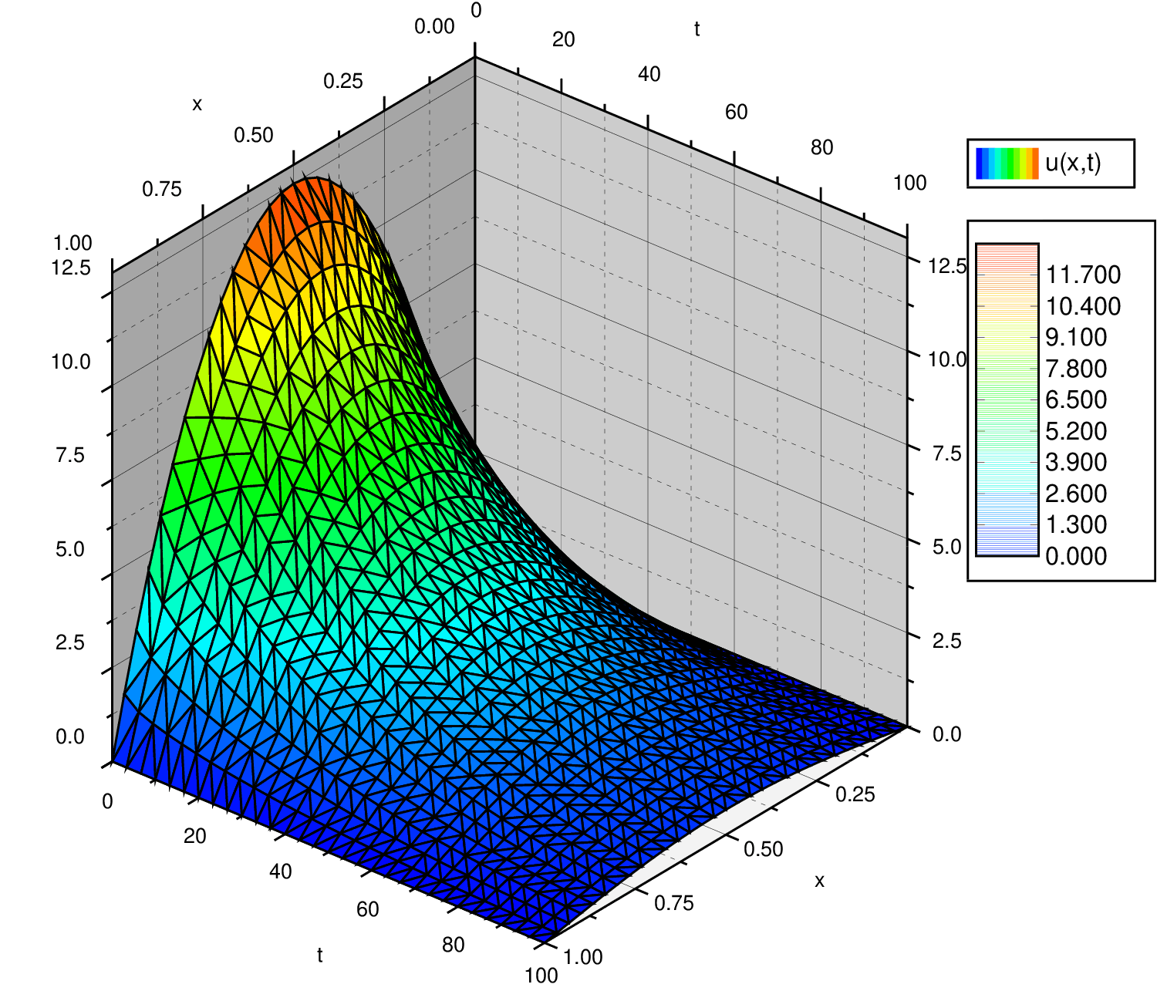

Partial Differential Equation (PDE):
A PDE is an equation which involves a multivariable function along with one or more of it’s partial derivatives
Heat Equation: (where αlpha is conductivity/(specific heat*density))
The heat equation is first order time and second order position
Since its creation, the heat equation has been fundamental to mathematics and developing science
Here’s a 3D plot of the equation:

Slide 4
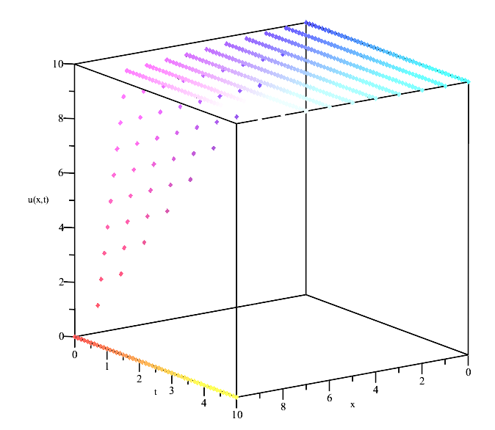
Finite Difference Method (FDM):
FDM is a numerical technique used to approximate solutions/derivatives to differential equations by discretizing them.
Take your governing equation
(ex. y”- y’- y = 0)
Set initial conditions/boundaries
(ex. y(0,t) = 0, y(x_max,t) = 10, y(x,0) = f(x))
Approximate your derivatives using forward, backward, or central difference method

Slide 5
Forward, Backward, and Central Difference Method:
Using a Taylor series expansion, the first derivative can be approximated as:
Forward Difference: ∂u/∂x ≈ (u(x + Δx) − u(x))/Δx, x exists at (x + Δx)/2
Backward Difference: ∂u/∂x ≈ (u(x) - u(x - Δx) )/Δx, x exists at (x - Δx)/2
Central Difference: ∂u/∂x ≈ (u(x + Δx) − u(x − Δx))/2Δx, x exists at x
This method is more accurate than the forward or backward difference since it uses a larger spatial range under u.

Slide 6

FDM Continued…
Discretize using i,j notation (so instead , where i ∈ 0, ..., m and j ∈ 0, ..., n)
Create a scheme to solve for the unknown
Create a matrix based on number of spatial steps (m) and time steps (n) (mxn matrix)
Insert boundary conditions into matrix and let the scheme do the rest of the work for the unknown
Use finalized matrix to help plot the FDM solution on a 3D graph
Preferable to use some sort of software to do the last two steps

Slide 7
Advection PDE:
A very important natural phenomenon associated with fire is advection.
Advection is the transport of a substance such as smoke or particles by the motion of a fluid (liquid or gas).
Advection describes how the substance moves with the flow of the medium
So in the case of a fire, it is combustion gases and particles being advected
(typical linear advection PDE)

Slide 8
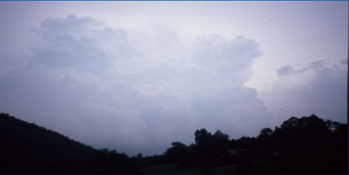
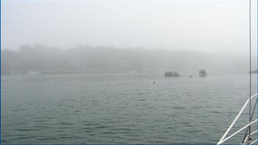
Convection vs. Advection:
Convection is the movement of a fluid, in response to temperature
Advection is transport of the substance within the fluid

Slide 9
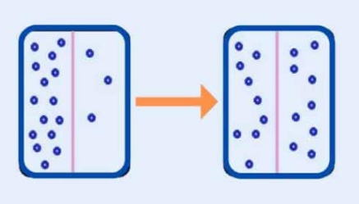
What is Diffusion?
Refers to the movement of particles from an area of high concentration to low concentration
Leads to equal distribution of particles through a system

Slide 10

Diffusion PDE:
Can be easily confused with advection
Looks deeper to the molecular level where agitation and/or small-scale turbulent or chaotic motions (wind) act to move substances randomly with respect to the mean motion of fluid
In this case combustion gases and particles are also being diffused as a result of airflow
(diffusion PDE)

Slide 11
Advection-Diffusion Equation:
What makes advection and diffusion convenient is we can combine them to make one PDE!
They also both affect the same substances as a result of airflow! (particles and combustion gases)
Since both PDEs are equal to ∂u/∂t, all we have to do is add a diffusion term to the end of the advection equation:

Slide 12


Set Initial Conditions/Boundaries:
u(0, t) = 0
u(N, t) = 0
v(x, t) = 1
u(x,0) = Asin(wx) where A = 1, and w = 1 in this case
This is because
This will give us a much more realistic solution to our advection-diffusion PDE because flame theory is heavily involved with fluid dynamics

Slide 13
Approximate Derivatives Using Central Difference:
PDE:
PDE Approximation:
where k = ∆t, h = ∆x
Scheme:

Slide 14
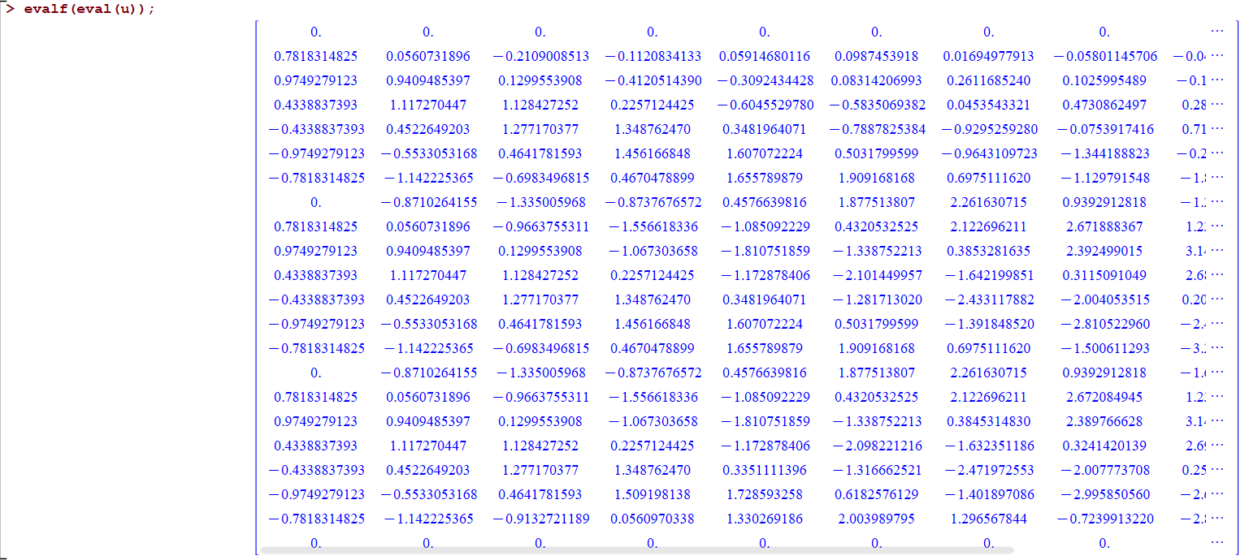
Resulting Matrix from ICs and Scheme (Maple using FDM):

Slide 15
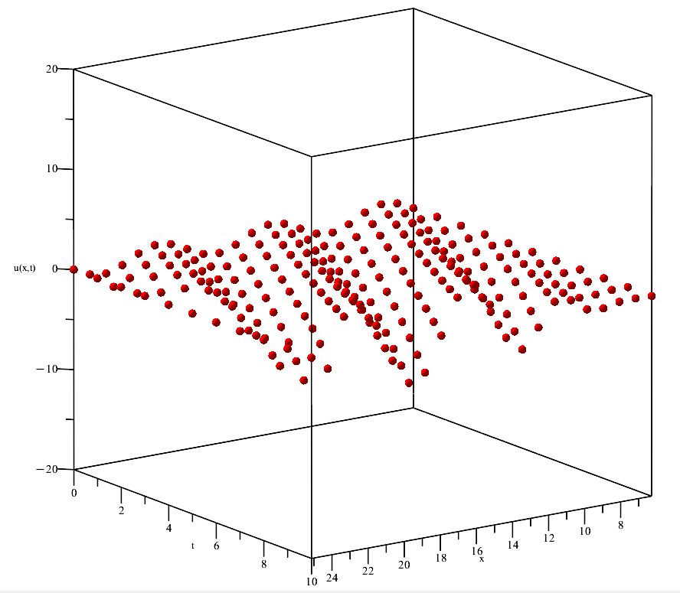
3D Plot (FDM):

Slide 16
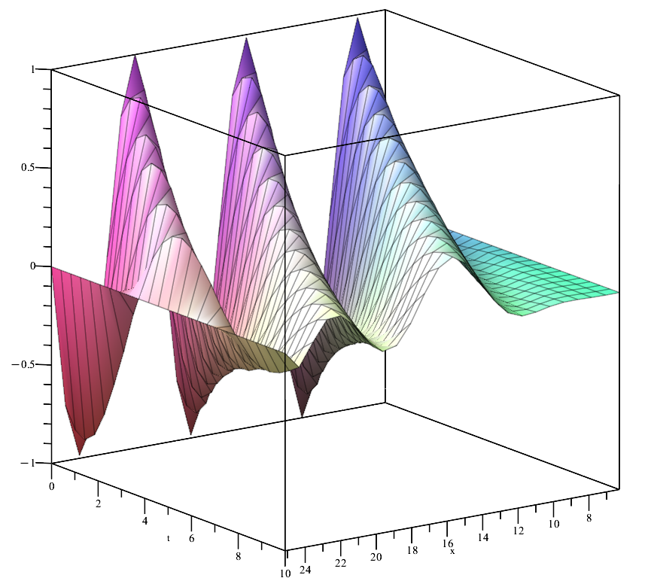
3D Plot using pdesolve() (Maple function for PDEs):

Slide 17
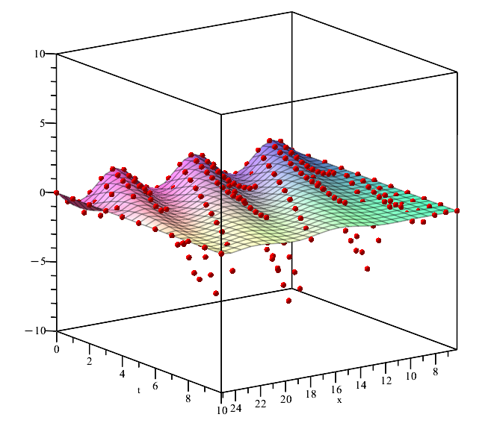
FDM and pdsolve() Plots Overlaid:

Slide 18

Velocity:
v(x, t) = x (instead of just 1)
This will provide us a more realistic model knowing that velocity can and will change due to outside factors

Slide 19
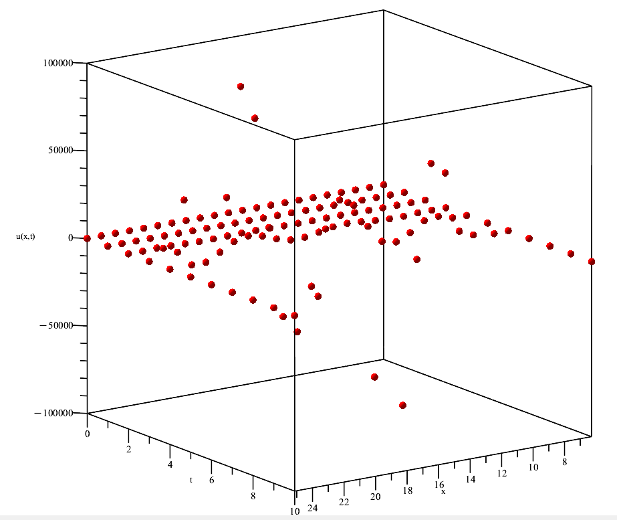
Resulting 3D Plot from New ICs and Scheme (FDM):

Slide 20
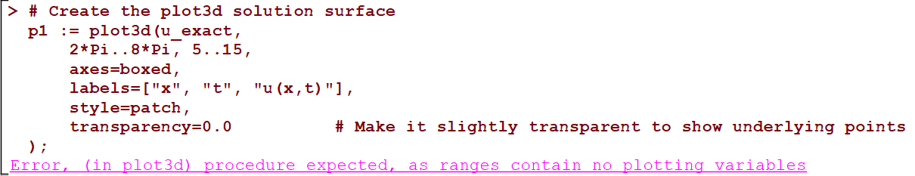
3D Plot from New ICs and Scheme (Maple pdsolve()):

Slide 21
HOW COULD THIS HAPPEN???
A numerical method performed better than Maple’s very own pdsolve()!
pdsolve() excelled in providing the exact solution to the constant coefficient PDE, but struggled when v(x, t) = x
FDM however, didn’t seem to have a problem at all in implementing a solution to our upgraded PDE and even plotted it for us
There was clearly diverging behavior but FDM still solved it (and quickly!)
Intuitively this makes some sense because all we have to do in this case is implement another i or j into our scheme to start the numerical calculations

Slide 22
Key Takeaways (What Actually Happened):
pdsolve() failed because it is a symbolic solver trying to find exact solutions using analytical techniques
This can only work when the PDE is linear, or has constant coefficients, or can be reduced to an ODE, or has known Laplace transforms
In this case, our PDE is linear but has a variable coefficient
This caused our pdsolve() function to keep itself in a constant state of evaluation w/ no solution

Slide 23
Continued…
FDM succeeds because the domain is discretized and derivatives are approximated numerically
This allows us to solve very complex/nonlinear PDEs w/out exact solutions
FDM doesn’t falter just because the equation cannot be solved symbolically

Slide 24
Interpretation/Conclusions:
Symbolic solvers are extremely fragile but produce amazing visuals
Can be great for learning and quick insight for specific, well-behaved PDEs.
Do not expect them to work for PDEs with variable coefficients, nonlinear terms, or irregular domains.
Numerical methods serve to be much more flexible when considering new ICs
Almost every practical PDE system (fluid dynamics, heat transfer, etc.) is solved numerically.
Try pdsolve() for small, simple cases (w/ constant coefficients for example)
Use FDM, or other numerical methods for general, complex PDEs.

Slide 25
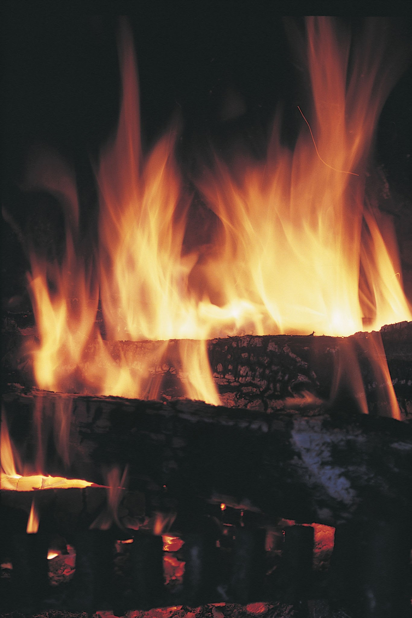
Future Considerations:
Higher dimensional models
(3D, add a ‘y’ term)
Nonlinear and chaotic systems (other nonlinear PDEs w/ turbulence model)
Integration with real data
Comparison with other numerical methods such as FEM, and FVM

Slide 26
Sources:
Arnold et. al (n.d.). Fire Simulation. Overview - Fire Simulation <br> Lecture Notes. https://firedynamics.github.io/LectureFireSimulation/content/overview/01_overview.html
Chan, A. (n.d.). Simulating Fluids, Fire, and Smoke in Real-Time. https://andrewkchan.dev/posts/fire.html
Ciarochi, J. (2020, August 4). How fire spreads: Mathematical models and simulators. DEV Community. https://dev.to/triplebyte/how-fire-spreads-mathematical-models-and-simulators-395c
https://student.cs.uwaterloo.ca/~cs475/CS475-Lecture04.pdf
Herman, R. (2015, June 19). Introduction to partial differential equations.https://people.uncw.edu/hermanr/pde1/PDEbook/Numerical.pdf
https://www.uni-muenster.de/imperia/md/content/physik_tp/lectures/ws2016-2017/num_methods_i/advection.pdf
Duffy, P. (n.d.). An introduction to finite difference methods for advection problems.https://maths.ucd.ie/met/msc/fezzik/Numer-Met/Linear_Advection.pdf

Slide 27

Thank you!

